Slide 1
Deep Reinforcement Learning
Research Trends

Slide 2

Reinforcement Learning

Slide 3
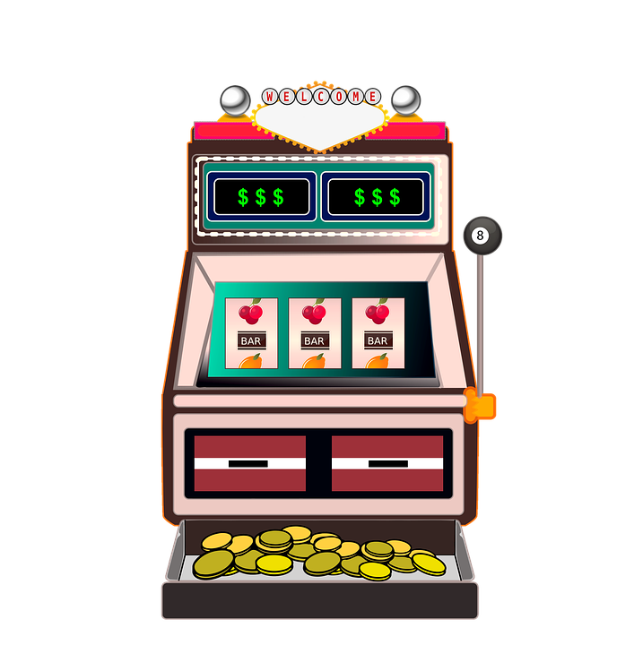

Hard Problems - Exploitation v.s. Exploration
The multi-armed bandit problem

Slide 4
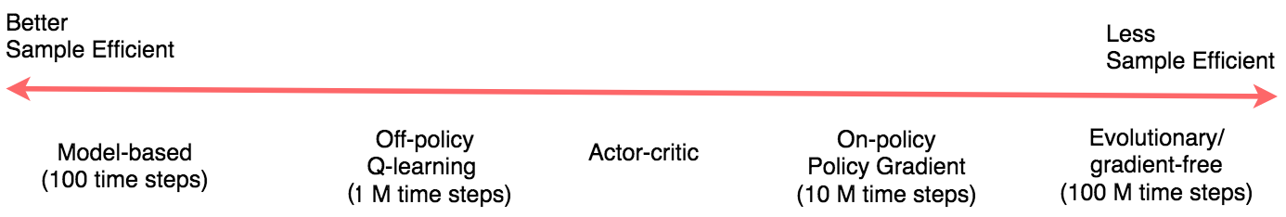
Hard Problems - Sample Efficiency

Slide 5
Deep RL Algorithms
According to rlpyt, model-free algorithms can be categorized into:
Policy Gradient
A2C
PPO
Deep Q-Learning
DQN
Double, Dueling DQN, and so on
Rainbow, etc.
Q-Function Policy Gradient
DDPG
TD3
SAC
Notes:
rlpyt 是 BAIR 開發的套件。它的 white paper 名字是 rlpyt: A Research Code Base for Deep Reinforcement Learning in PyTorch

Slide 6
Outlines
Model-based RL
Large-scale RL projects
Meta-RL
Priors
Multi-agent RL
Notes:
1. 可以被 model 的環境用 model-based 解會更好、且更有效率（model-based RL）
2. 但 model-based 有點麻煩，有時候 model-free 也可以解決很困難的問題（large-scale projects）
3. 但 large-scale 實在太難 train 了，所以 meta RL 可以更有效率的學習新的 task（meta RL）
4. 我們也能運用預先 distill 好的知識作為 prior distribution 來進行快速學習（Priors）
5. 如果 single agent 還不夠難，還有更難的 multi-agent RL（multi-agent RL）

Slide 7
Model-based RL

Slide 8
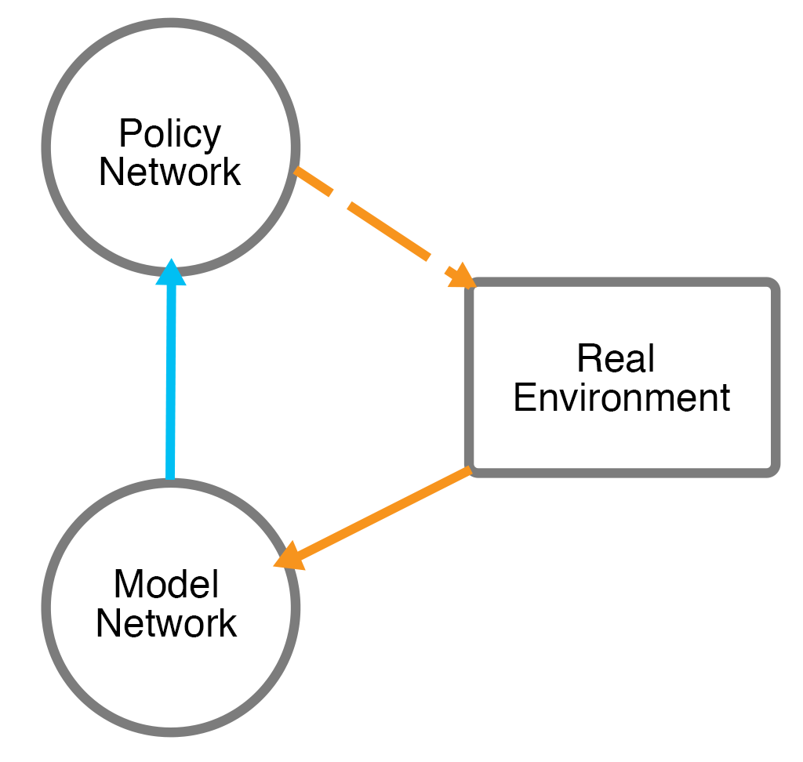
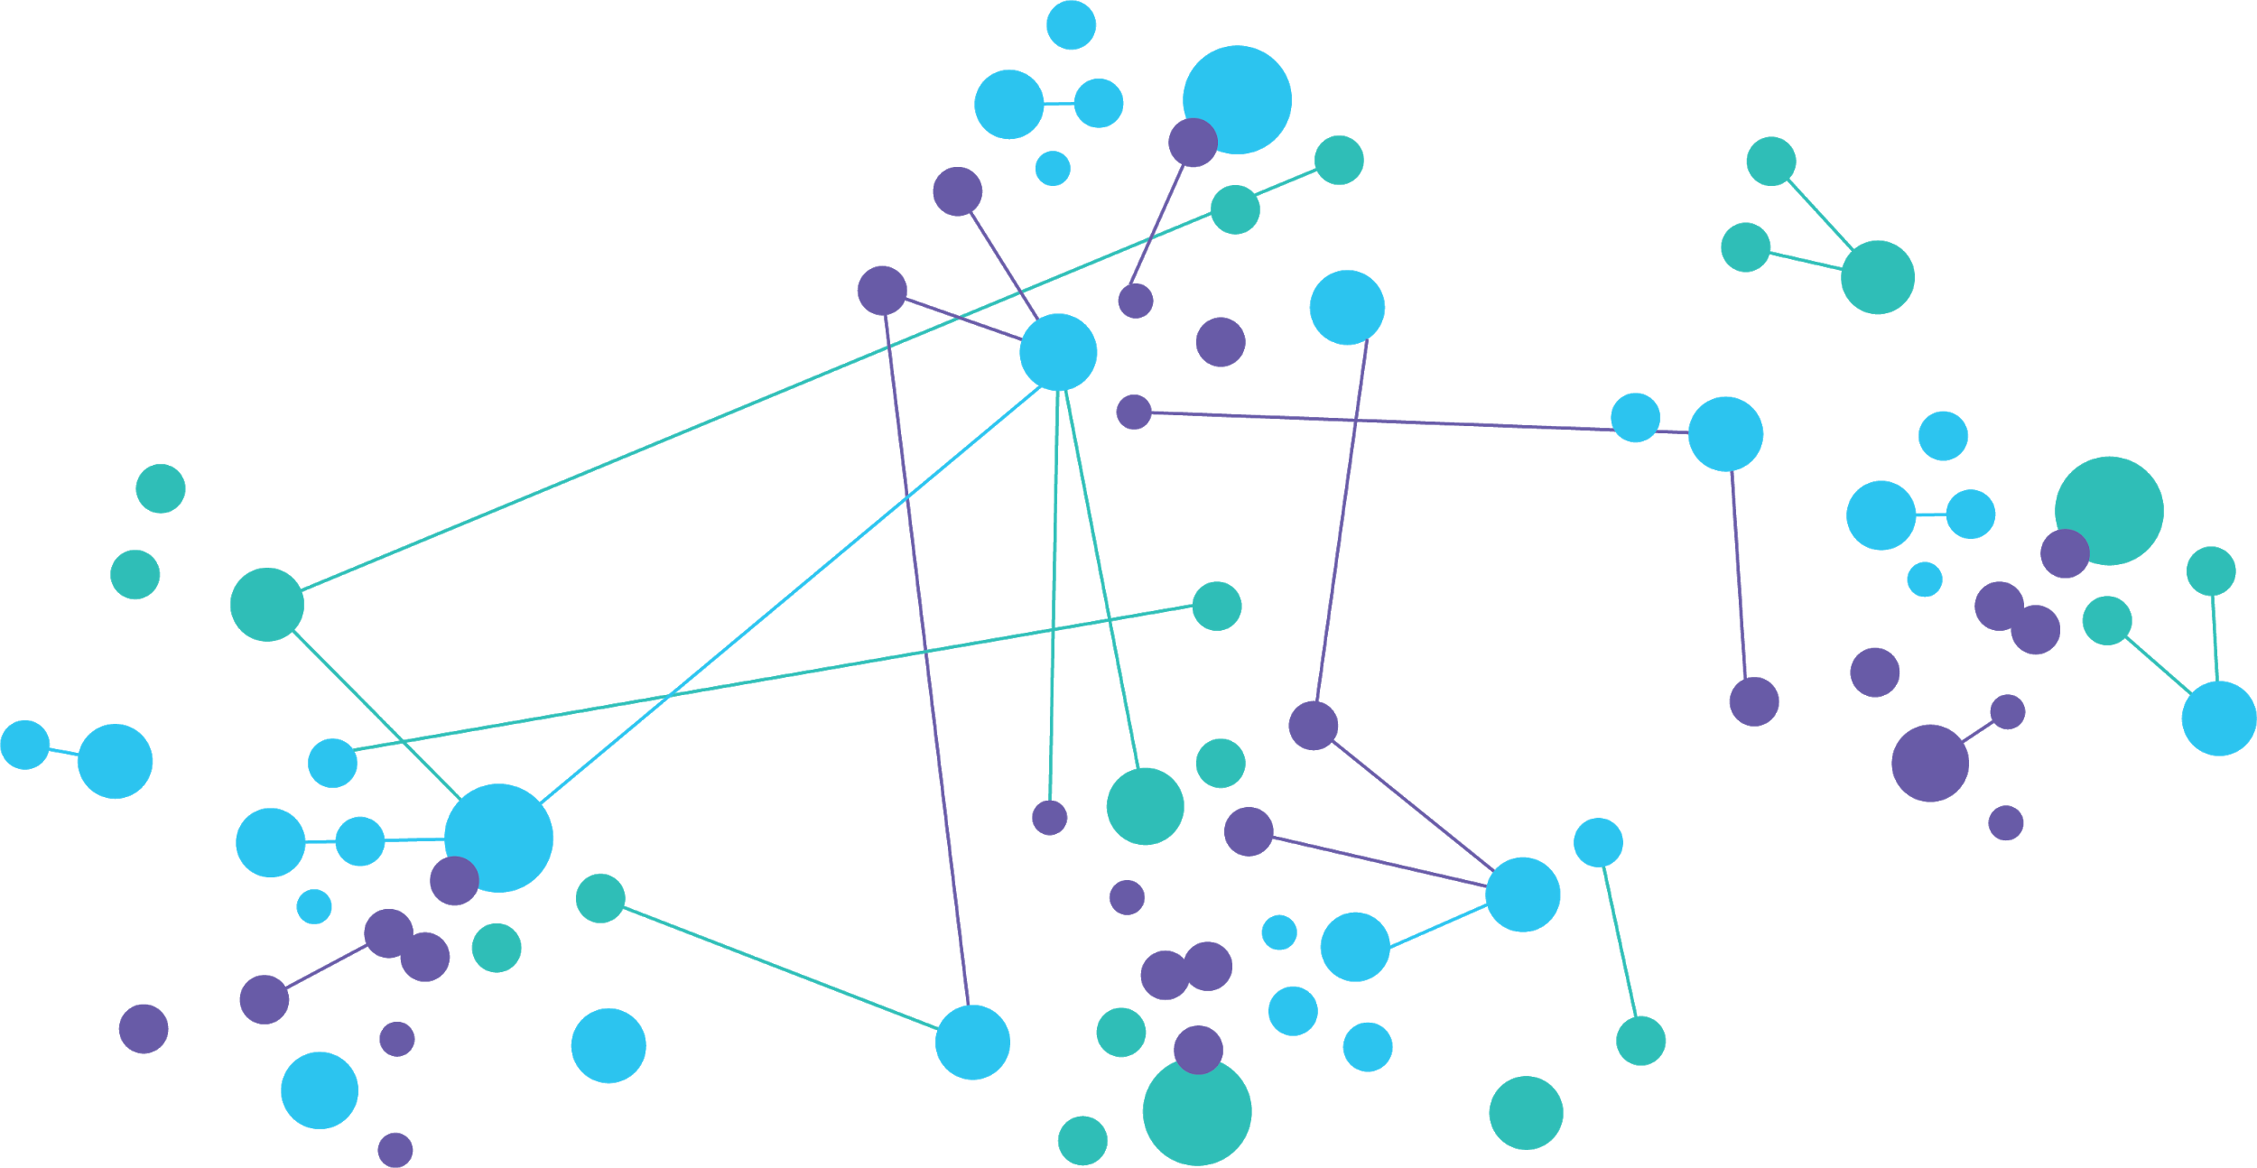
What does Model-based RL base on?

Slide 9
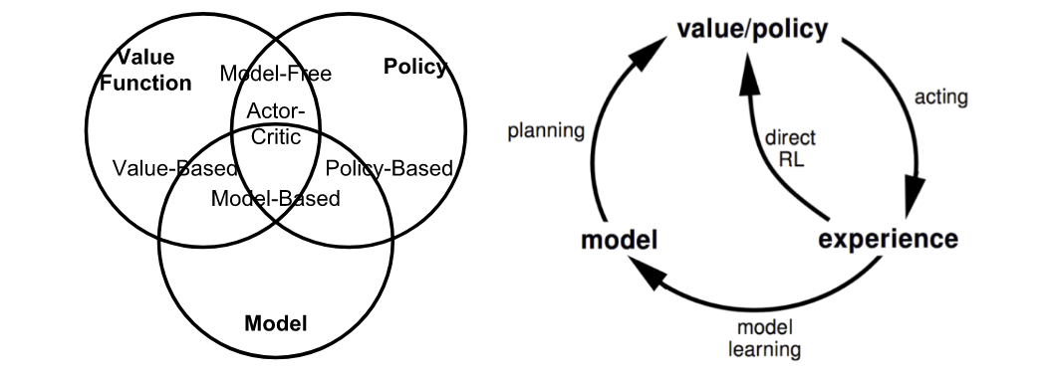
How to Model-based RL?
Have access to the environment (a perfect simulator)
Learn a model to represent the environment

Slide 10
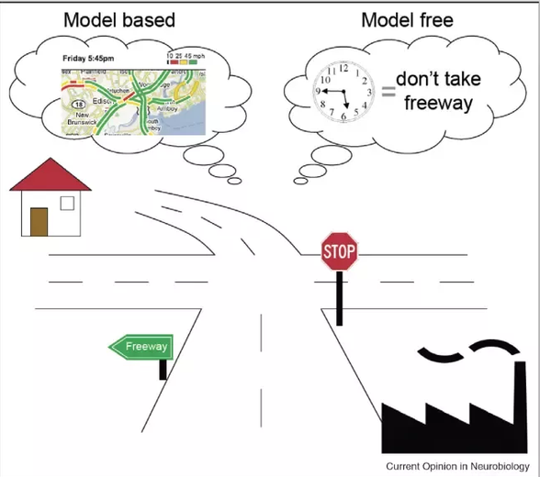
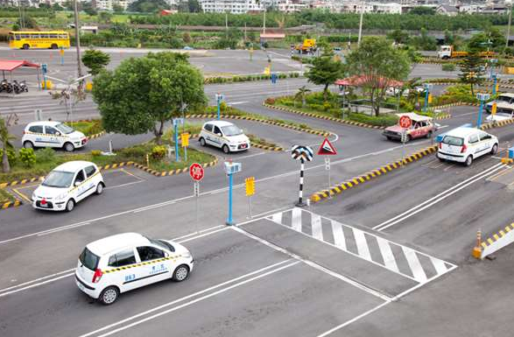
Pros & Cons
Model may not represent the real world
Model could be useful for planning

Slide 11
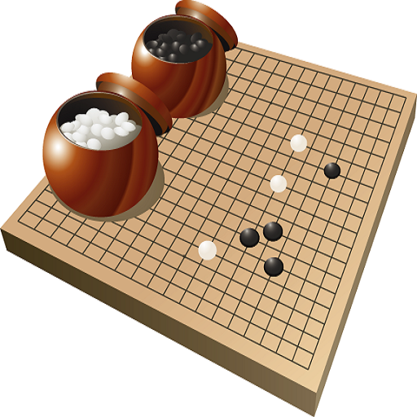
The Evolution of AlphaGo to MuZero
AlphaGo ⟶ AlphaGo Zero ⟶ AlphaZero ⟶ MuZero

Slide 12
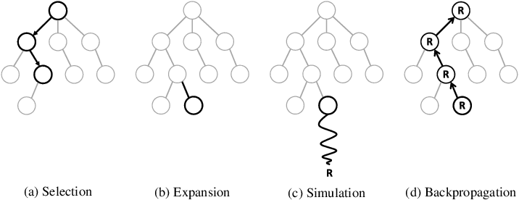
AlphaGo
Training:
Pre-train the policy network using Supervised Learning
Self-play and improve the policy network using Policy Gradient
Train the value network with state-result pairs (collected during Self-play)
Inferencing using MCTS:
Expand a tree node according to the policy network
Evaluate states with the help of value network
Notes:
Mastering the game of Go with deep neural networks and tree search (DeepMind, January 2016)

Slide 13
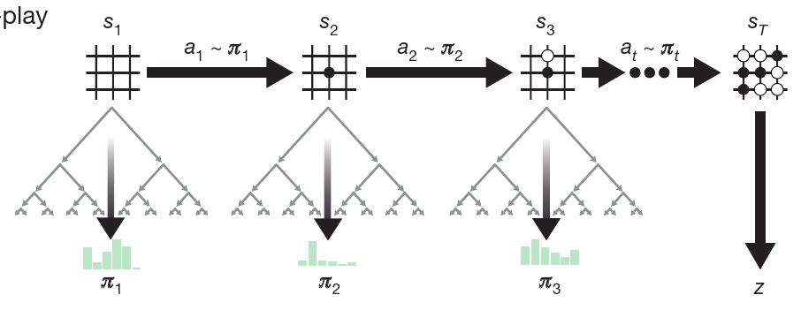
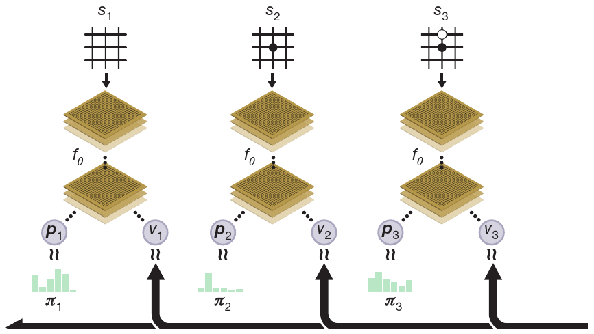
AlphaGo Zero
No pre-training
Self-play (with v.s. without MCTS)
Network training (separately v.s. jointly trained networks)
Notes:
Mastering the game of Go without human knowledge (DeepMind, October 2017)

Slide 14
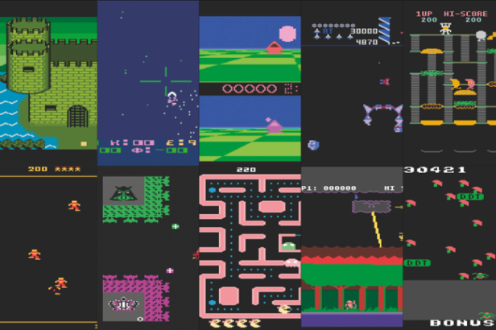

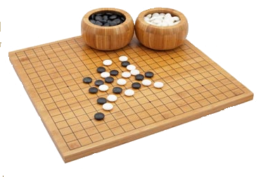
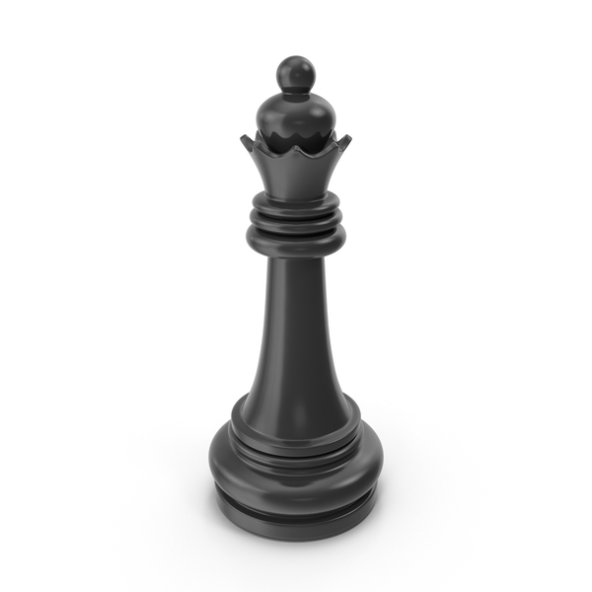
MuZero (1/3)
No perfect simulator anymore
Notes:
Mastering Atari, Go, Chess and Shogi by Planning with a Learned Model (DeepMind, Nov 2019)
不再有 perfect simulator。

Slide 15
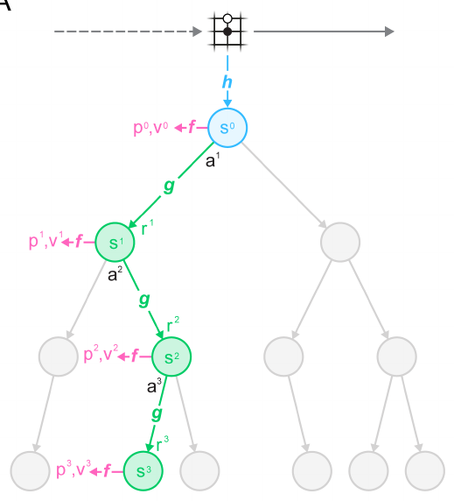
MuZero (2/3)
MuZero are composed of 3 networks:
representation (h), dynamics (g), and prediction (f)
Notes:
AlphaGo Zero 整個 network 就像是 MuZero 的 prediction network。
The initial hidden state s0 is obtained by passing the past observations (e.g. the Go board or Atari screen) into a representation function h.

Slide 16
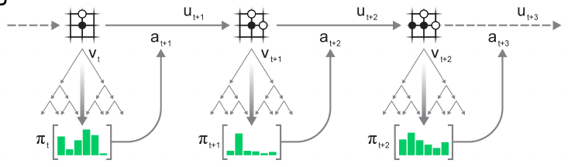
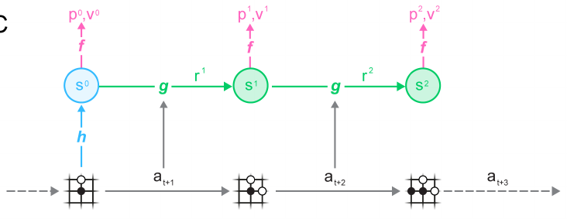
MuZero (3/3)
Acting in environments
Training models jointly
Notes:
How MuZero trains its model.
A trajectory is sampled from the replay buffer.
For the initial step, the representation function h receives as input the past observations o1, ..., ot from the selected trajectory.
The model is subsequently unrolled recurrently for K steps.
At each step k, the dynamics function g receives as input the hidden state sk−1 from the previous step and the real action at+k .
The parameters of the representation, dynamics and prediction functions are jointly trained, end-to-end by backpropagation-through-time, to predict three quantities: the policy pk ≈ πt+k , value function v k ≈ zt+k , and reward rt+k ≈ ut+k , where zt+k is a sample return: either the final reward (board games) or n-step return (Atari).

Slide 17
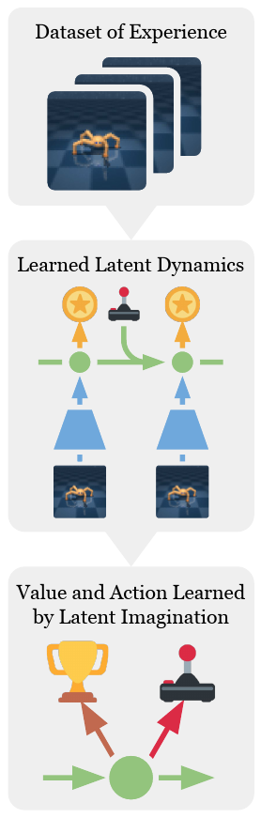
Dream to Control (1/2)
Learn dynamics using representation learning
Representation
Transition
Reward
Learn behavior with imagined trajectories
Action
Value
Notes:
Dream to Control: Learning Behaviors by Latent Imagination (ICLR 2020, Google Brain + DeepMind + University of Toronto)
不需要 tree search。
We present Dreamer, a reinforcement learning agent that solves long-horizon tasks from images purely by latent imagination.
We efficiently learn behaviors by propagating analytic gradients of learned state values back through trajectories imagined in the compact state space of a learned world model.

Slide 18
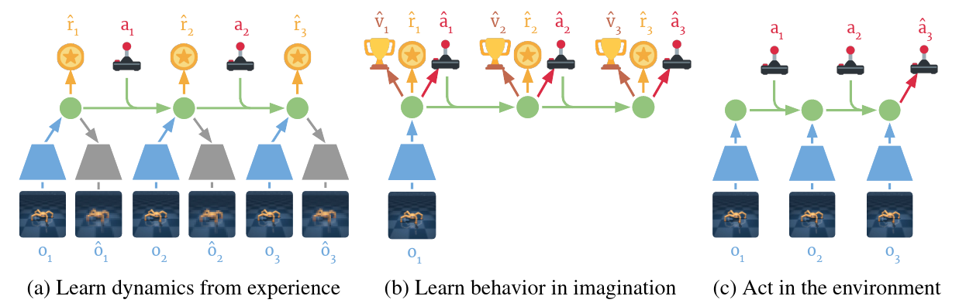
Dream to Control (2/2)
Notes:
observation 和 state 是分開的。
沒有 planning

Slide 19
Large-scale RL Projects

Slide 20
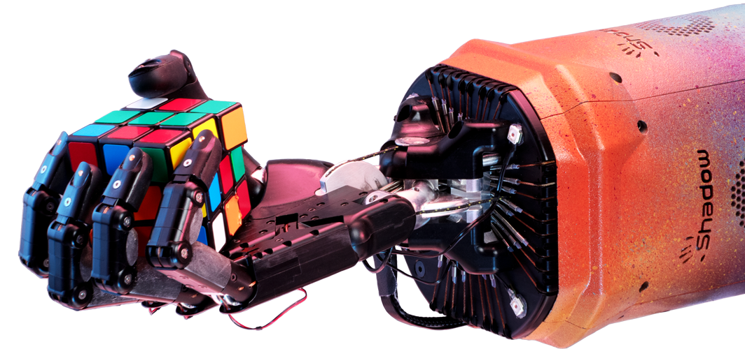
Solving Rubik's Cube with a Robot Hand
Notes:
Solving Rubik's Cube with a Robot Hand (OpenAI, October 2019)

Slide 21
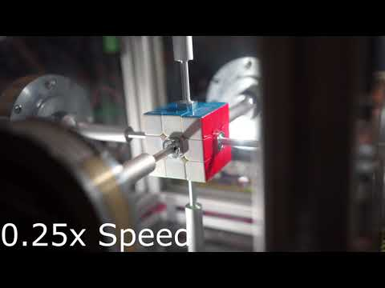
Solving Rubik's Cube (Traditional Way?)

Slide 22
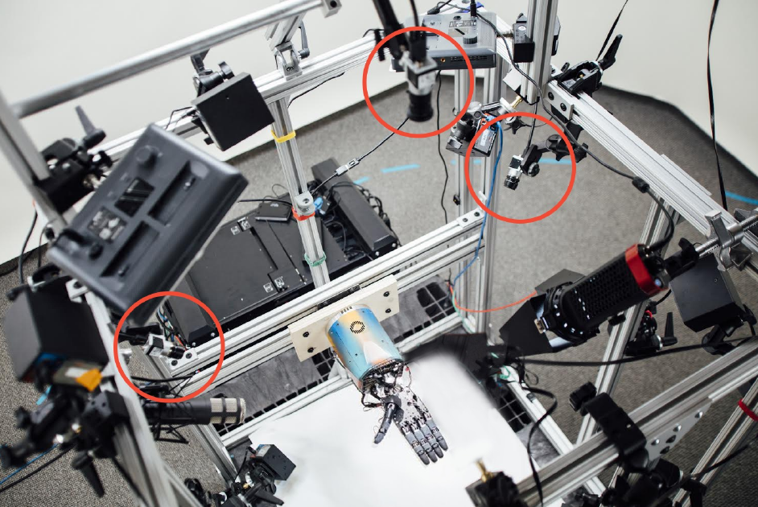
Problem Definition (1/4) - Observation

Slide 23
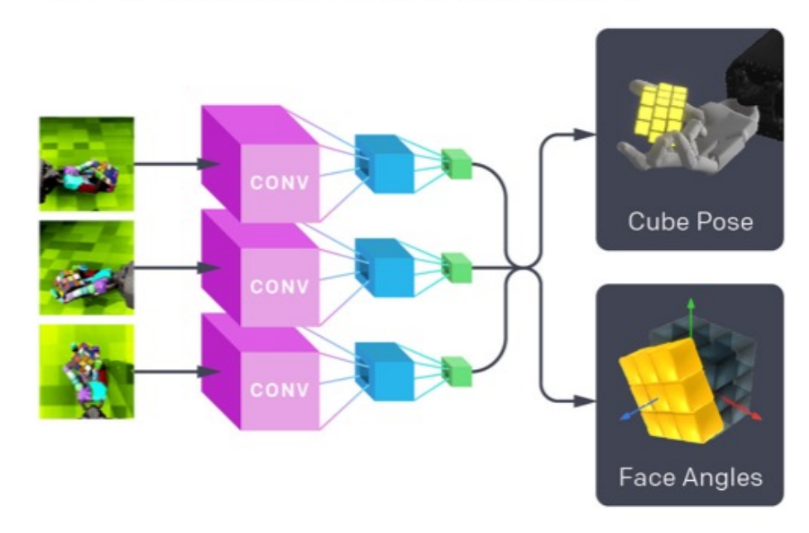
Problem Definition (2/4) - State

Slide 24
Problem Definition (3/4) - Action
Set of actions are known
Discrete; 11 bins for each action coordinate:
3 joints
Finger tip
Relative movement to current position

Slide 25
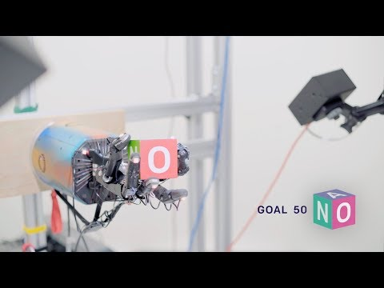
Problem Definition (4/4) - Reward
Block reorientation (appeared in the previous work)

Slide 26
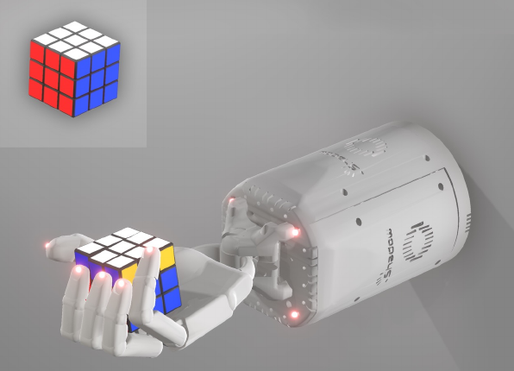
Sim2real Transfer
Train in simulation, transfer to the real world

Slide 27
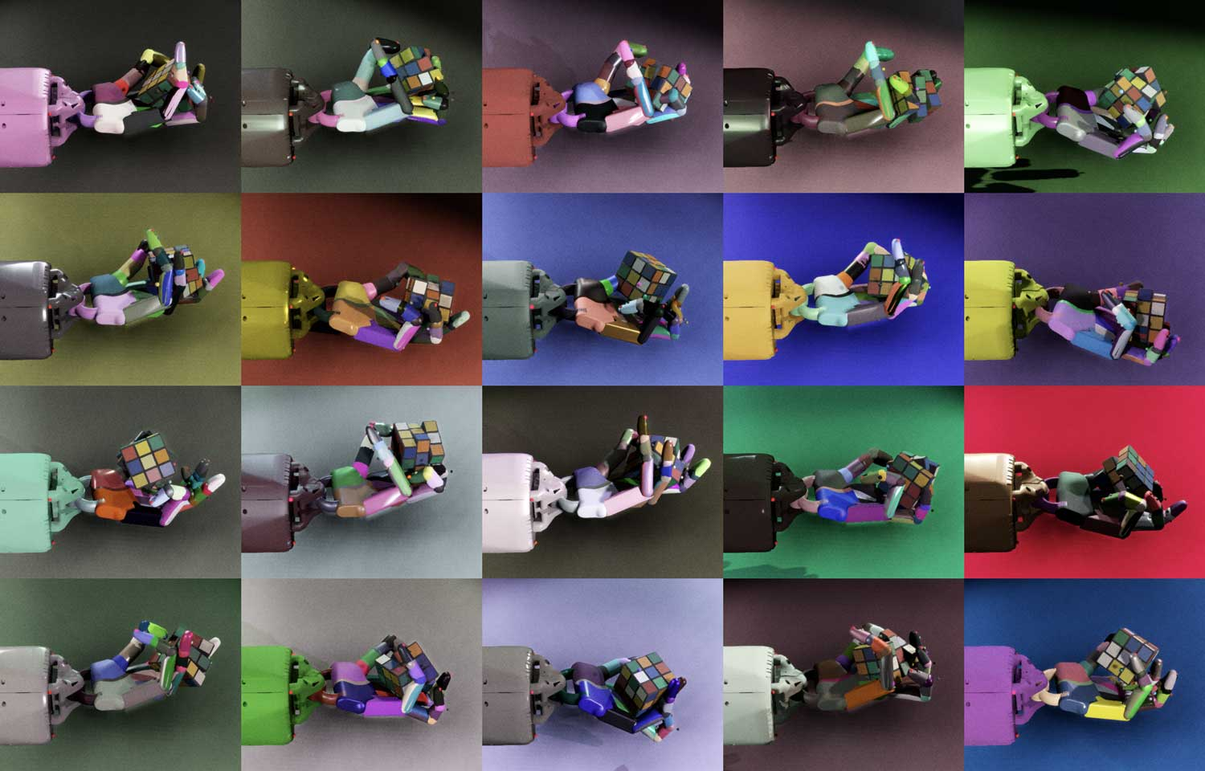
Domain Randomization
"How do we create complex enough worlds where they can learn?"

Slide 28
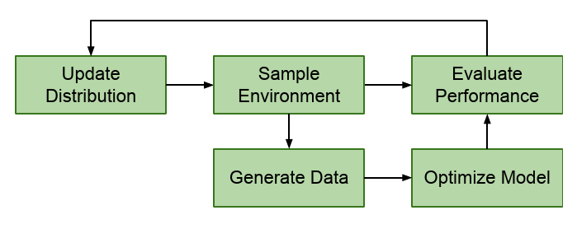
Automatic Domain Randomization
Endlessly generate progressively more difficult environments in simulation.
Environment parameters:
The friction of the robot fingers
The size of the cube
The mass of the cube, etc.

Slide 29
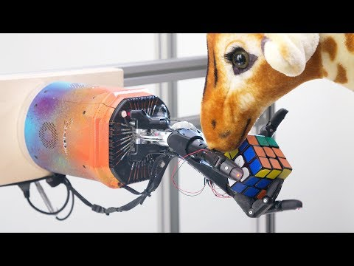
Result
Training on 64 NVIDIA V100 + 32 CPU cores for several months

Slide 30
Meta-RL

Slide 31
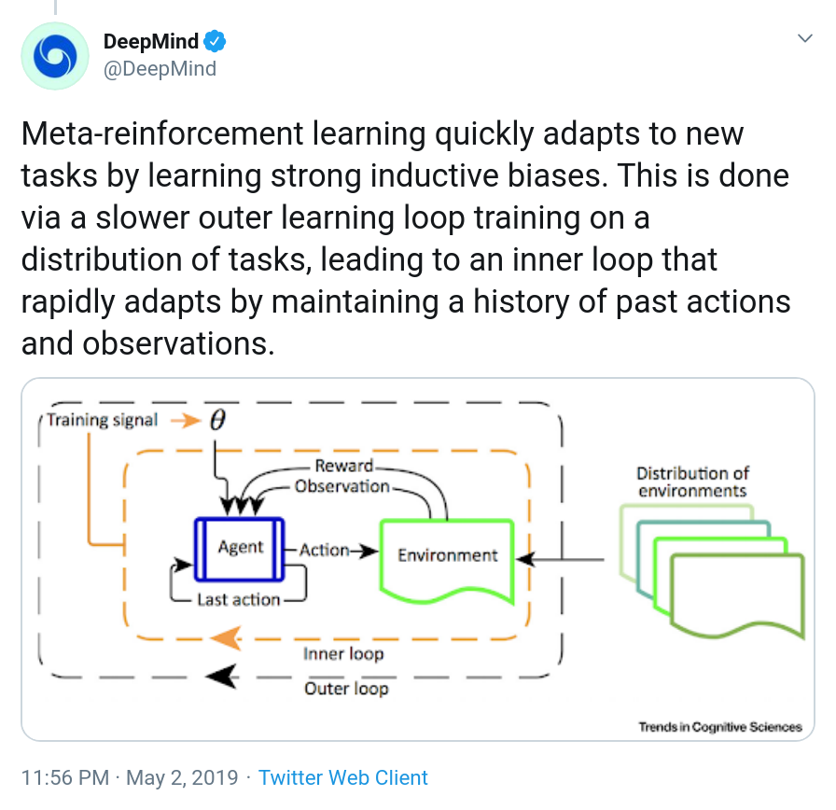
What is Meta-RL?

Slide 32
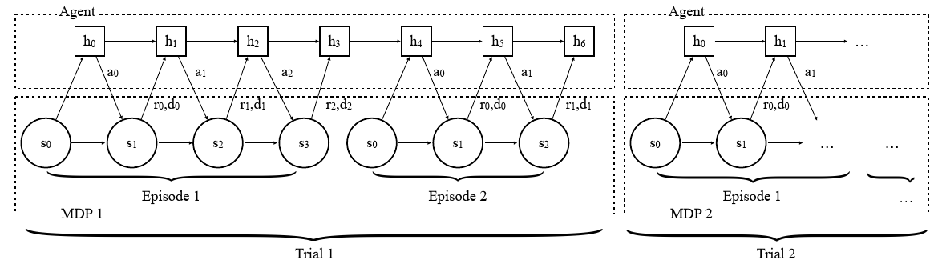
The Origin of Deep Meta-RL
Main difference from RL:
Notes:
RL^2: Fast Reinforcement Learning via Slow Reinforcement Learning (UCB + OpenAI, ICLR 2017)
Learning to Reinforcement Learn (DeepMind, Nov 2016)
學習新的 task 時，清空 agent 的 memory，agent 依舊可以快速 adapt 至新的 task 上。

Slide 33
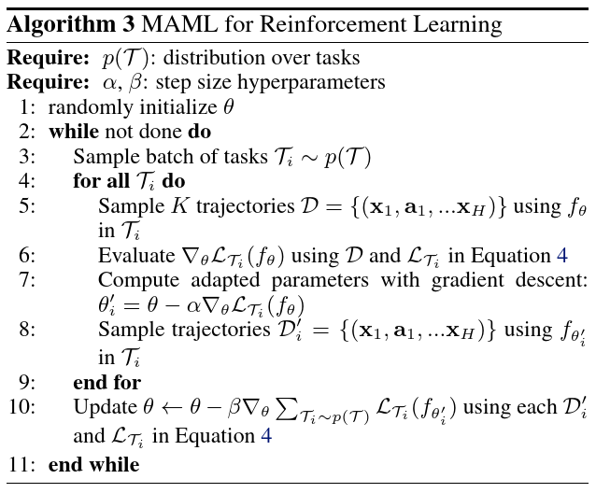
Meta Learn Model Weights
Notes:
Model-Agnostic Meta-Learning for Fast Adaptation of Deep Networks (UCB, ICML 2017)

Slide 34
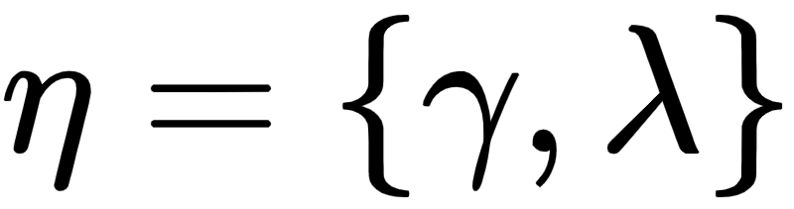
Meta Learn Hyperparameters
Define the return function to be:
A typical RL algorithm would hand-select the meta-parameters. Instead, we can view the return as a function parameterised by meta-parameters:
Notes:
Meta-Gradient Reinforcement Learning (DeepMind, May 2018)
The meta-parameters η are adjusted online during the agent’s interaction with the environment, allowing the return to both adapt to the specific problem, and also to dynamically adapt over time to the changing context of learning.
We derive a practical gradient-based meta-learning algorithm and show that this can significantly improve performance on large-scale deep reinforcement learning applications. (SOTA performance on Atari 2600)
1. Starting with parameter θ, the policy πθ is updated on the first batch of samples τ, resulting in θ′.
2. Then we continue running the policy πθ′ to collect a new set of experiences τ′, just following τ consecutively in time. The performance is measured as J(τ′,θ′,η¯) with a fixed meta-parameter η¯.
3. The gradient of meta-objective J(τ′,θ′,η¯) w.r.t. η is used to update η
meta-gradient 是算在 meta-objective 上，而 meta-objective 就像是在算 advantage，透過估算一個 state-value 作為 baseline 來當作 meta-objective 更新 meta-parameters。

Slide 35
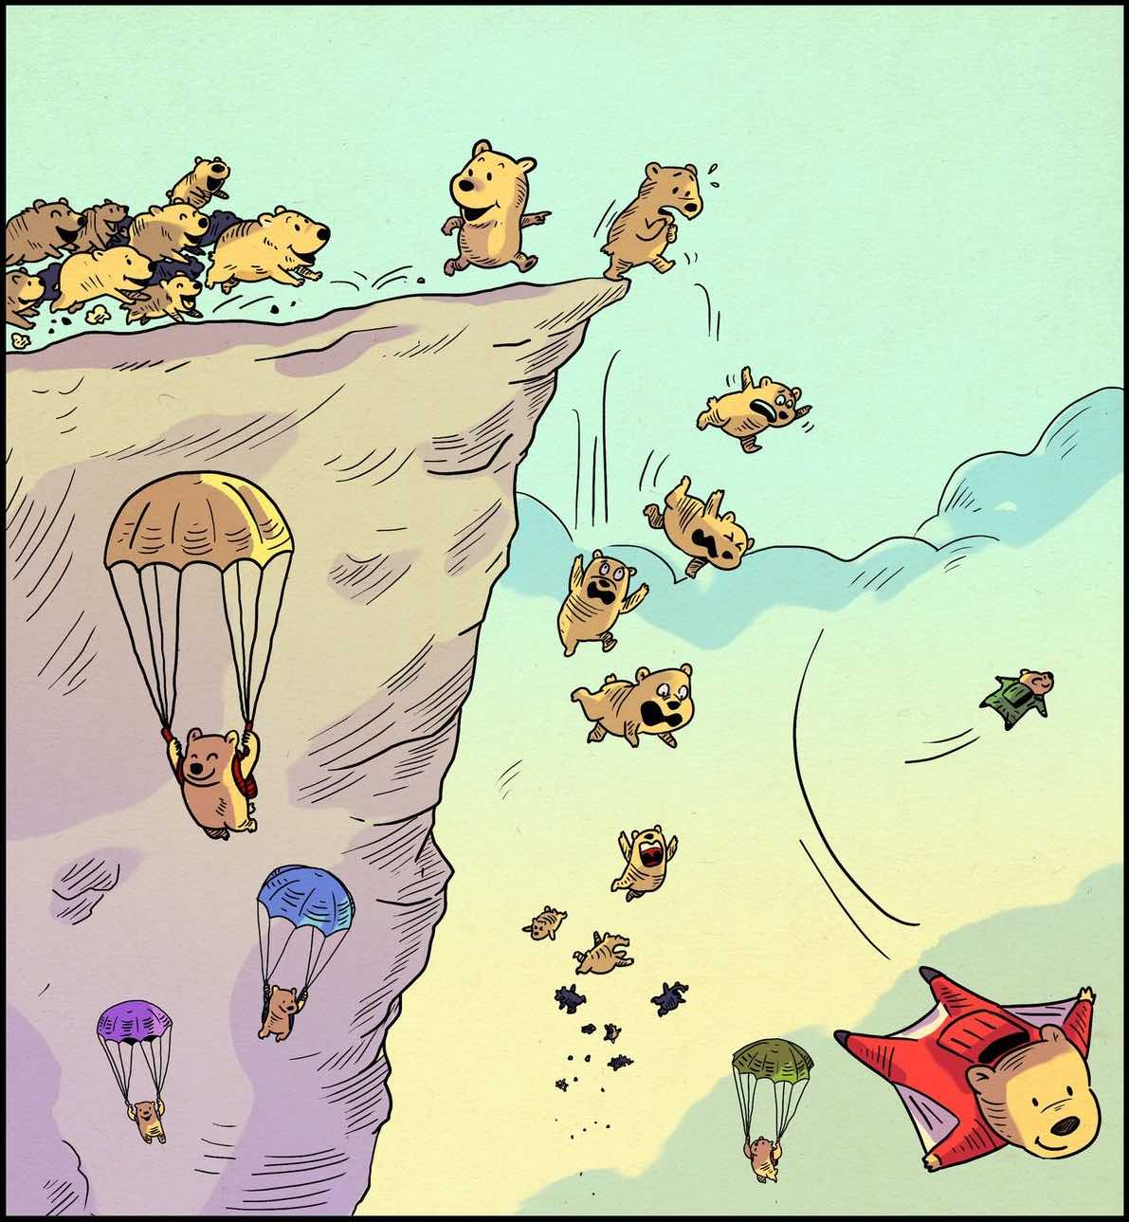
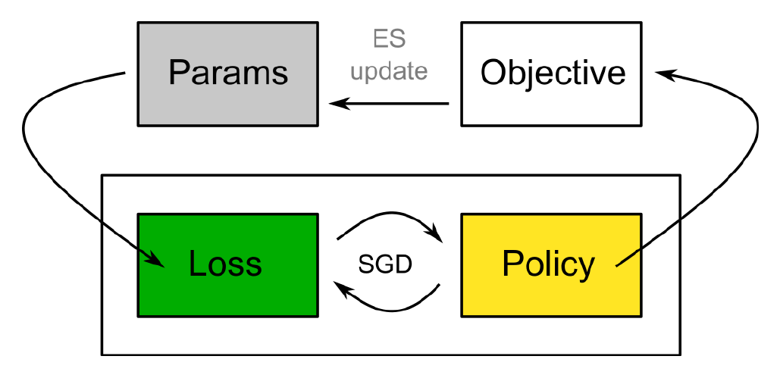
Meta Learn Loss Functions
Evolution strategies
Notes:
Evolved Policy Gradients (OpenAI + UCB + MIT, Feb 2018)
Our aim in this paper is to devise agents that have a prior notion of what constitutes making progress on a novel task.
Rather than encoding this knowledge explicitly through a learned behavioral policy, we encode it implicitly through a learned loss function.
The end goal is agents that can use this loss function to learn quickly on a novel task.
This loss function consists of temporal convolutions over the agent’s recent history.
This loss could have several other positive effects.
For example, by examining the agent’s history, the loss could incentivize desirable extended behaviors, such as exploration.
Further, the loss could perform a form of system identification, inferring environment parameters and adapting how it guides the agent as a function of these parameters (e.g., by adjusting the effective learning rate of the agent).

Slide 36
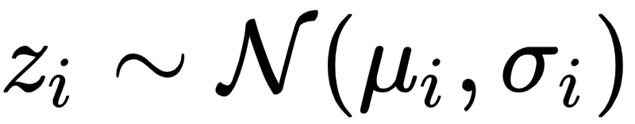
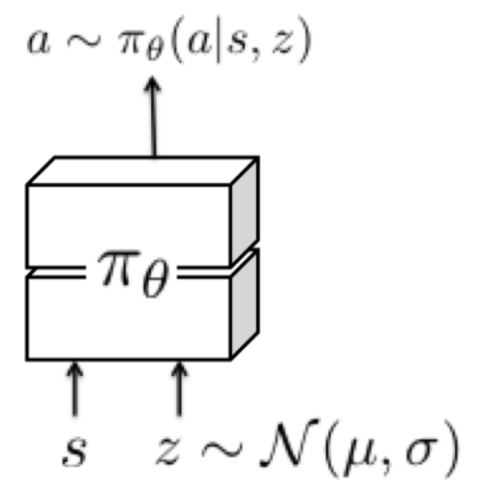
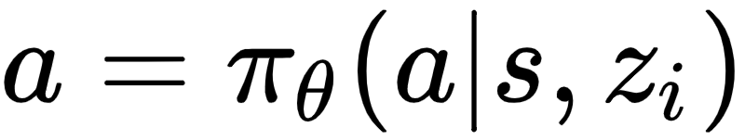
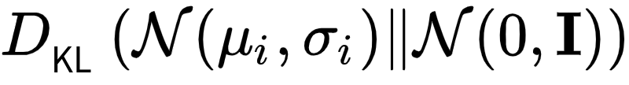
Meta Learn Exploration Strategies
Per-task random variable
The policy becomes
The loss function includes
Notes:
Meta-Reinforcement Learning of Structured Exploration Strategies (UCB, Feb 2018)

Slide 37
Priors

Slide 38
What is Prior?
To obtain effective and fast-adapting agents, the agent can rely upon previously distilled knowledge in the form of a prior distribution.
The following two papers propose two distinct ways:
Simultaneous learning of a goal-agnostic default policy
Learning a dense embedding space to represent a large set of expert behaviors

Slide 39
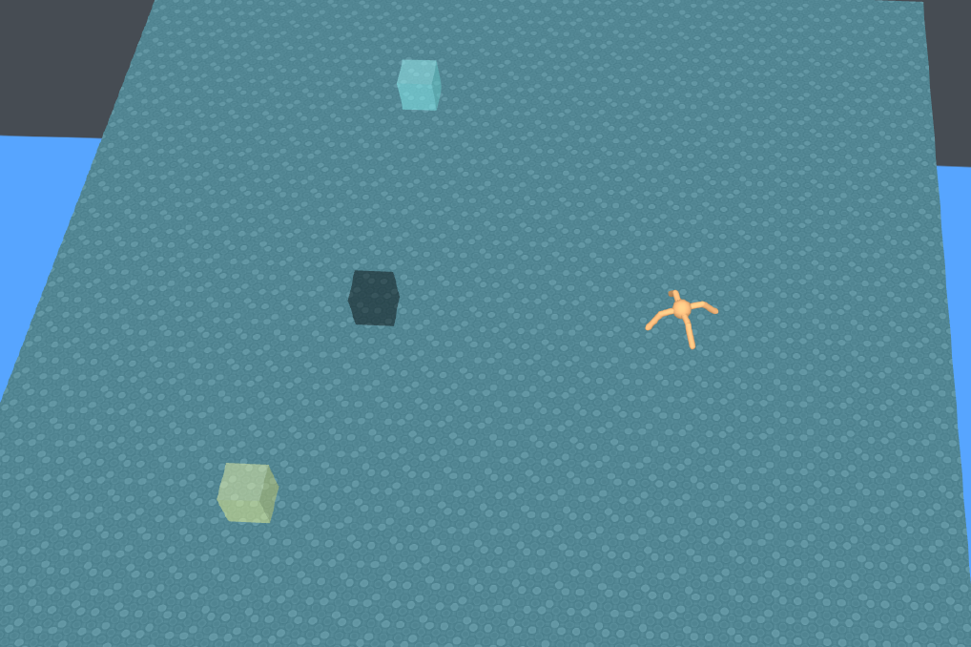
Goal-agnostic Prior Policy (1/2)
Notes:
Information Asymmetry in KL-Regularized RL (DeepMind, May 2019)
In these experiments, we consider two streams of information which are fed to our agents: task specific information (task) and proprioception (proprio), corresponding to walker (body) specific observations (joint angles etc.).

Slide 40
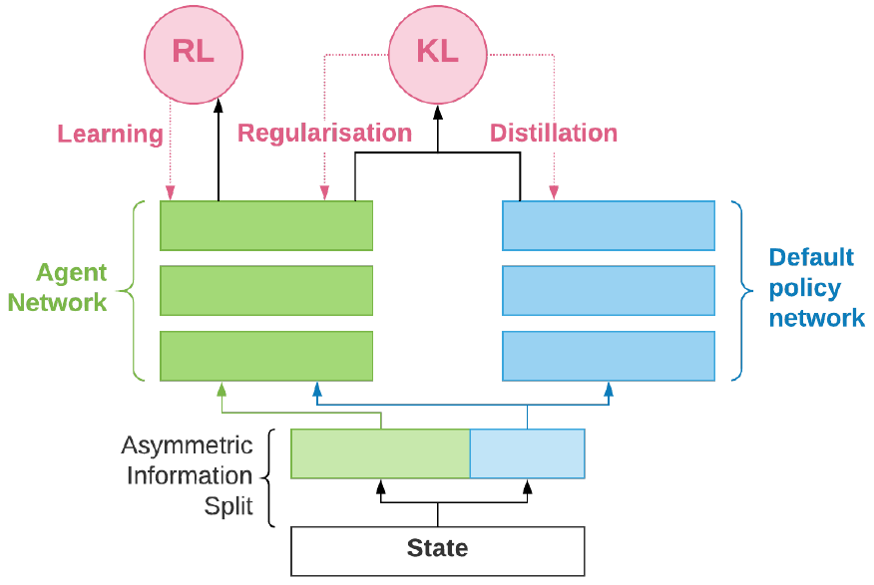
Goal-agnostic Prior Policy (2/2)
Notes:
A simple approach is to perform alternating gradient ascent in π 0 and π.
Optimizing L with respect to π0 amounts to supervised learning with π as the data distribution (distilling π into π ).
Optimizing π given π requires solving a regularized expected reward problem which can be achieved with a variety of algorithms.

Slide 41
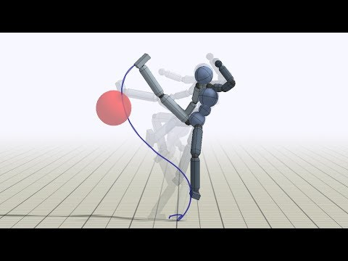
Learn from Experts (1/3)
360 turning kick
Backflip
Kick-up & Kick
Notes:
Neural Probabilistic Motor Primitives for Humanoid Control (DeepMind, ICLR 2019)

Slide 42
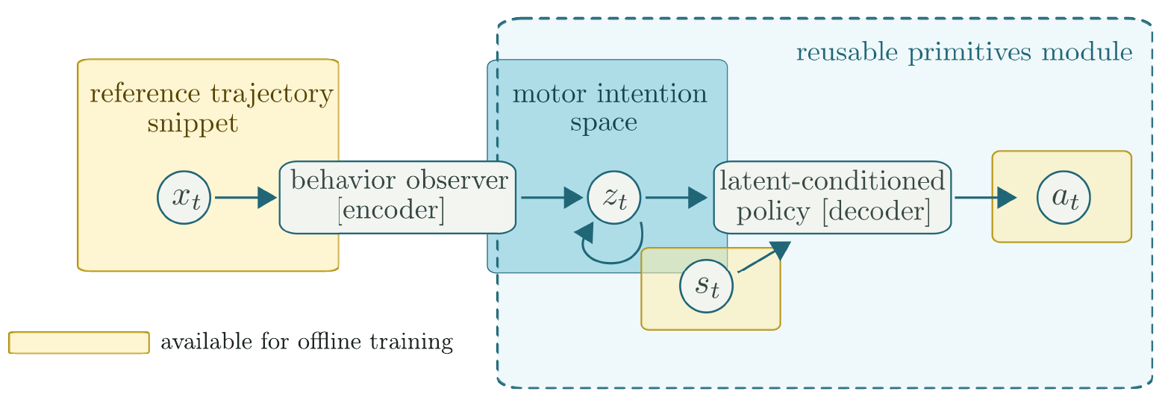
Learn from Experts (2/3)
Notes:
We achieve this goal by training an autoregressive latent variable model of the state-conditional action sequence which, at training time, is conditioned on short look-ahead snippets of the nominal/reference trajectory.
This architecture has the general structure of an inverse model, which produces actions based on the current state and a target.

Slide 43
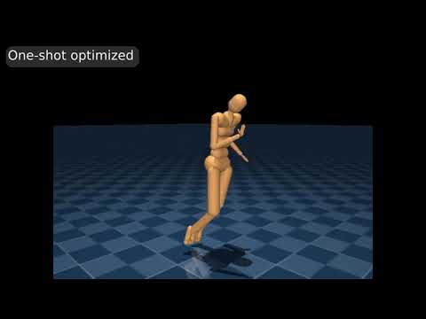
Learn from Experts (3/3)
The trained agent is able to perform one-shot Imitation.

Slide 44
Multi-agent RL

Slide 45

Multi-agent v.s. Single-agent
Agents interact with environment and potentially with each other, which makes multi-agent learning a more complex problem.
And there are some problems:
Optimal policy is dependent on the other agents' policies.
Convergence to optimal behavior is not guaranteed.

Slide 46
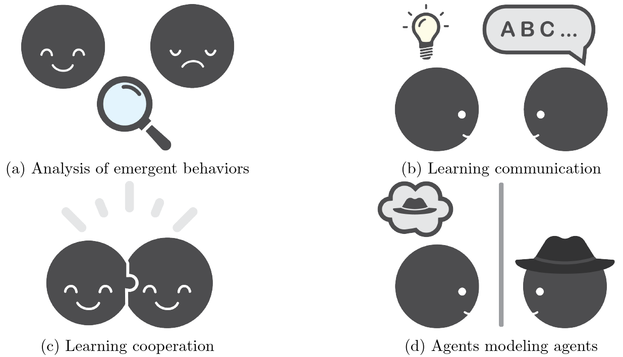
Categories of Different Multi-agent RL Works
Notes:
A Survey and Critique of Multiagent Deep Reinforcement Learning (Borealis AI, Oct 2018)

Slide 47
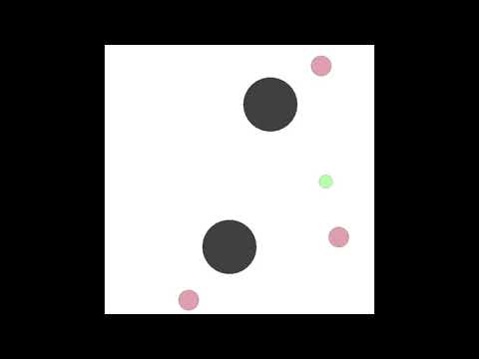
MADDPG (1/2)
Notes:
Multi-Agent Actor-Critic for Mixed Cooperative-Competitive Environments (OpenAI + McGill + UCB, June 2017)
We have argued in the previous section that naïve policy gradient methods perform poorly in simple multi-agent settings.

Slide 48
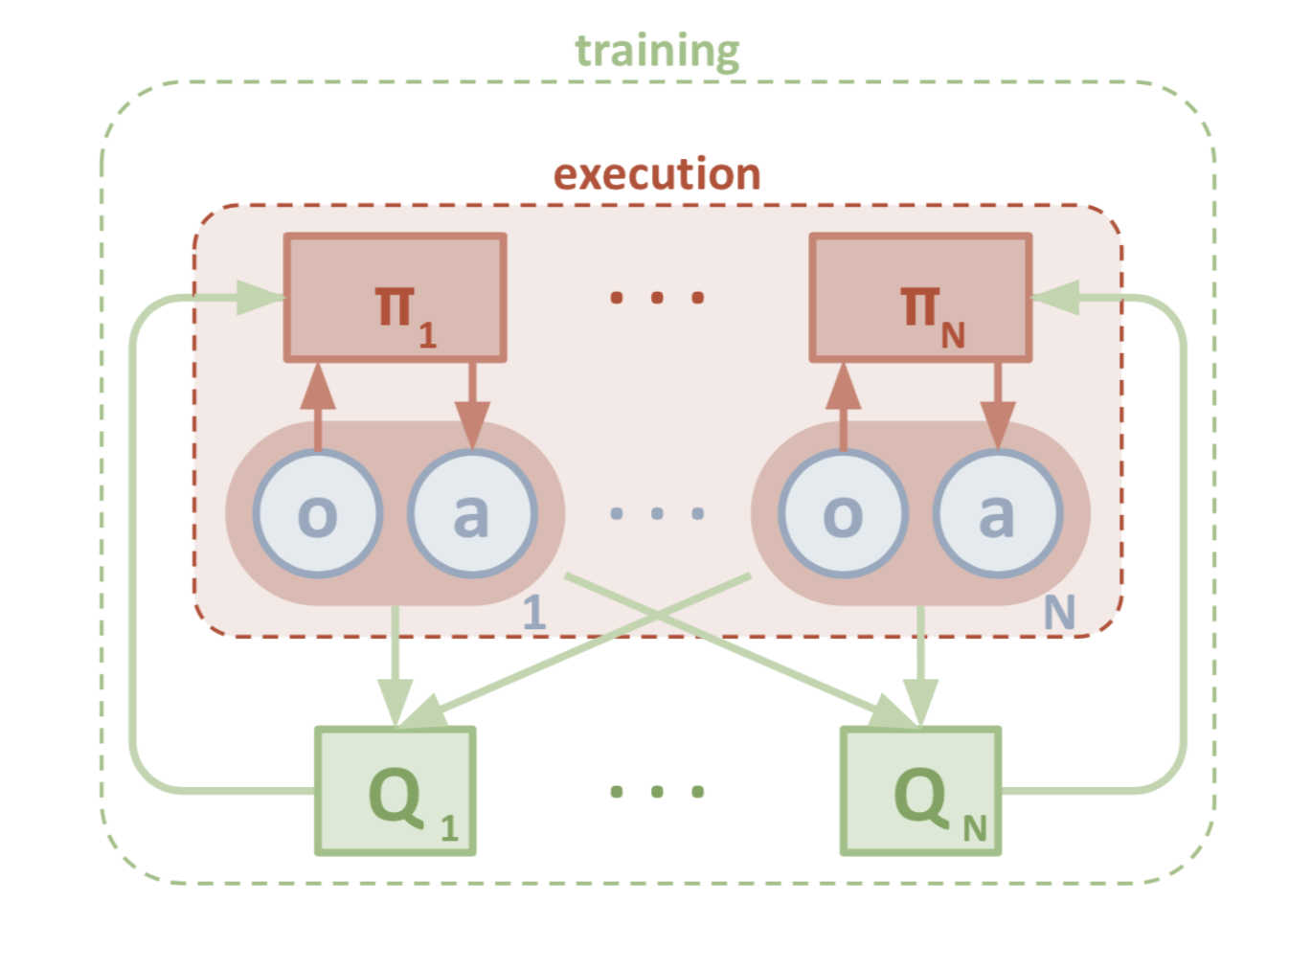
MADDPG (2/2)
Notes:
we propose a simple extension of actor-critic policy gradient methods where the critic is augmented with extra information about the policies of other agents.

Slide 49
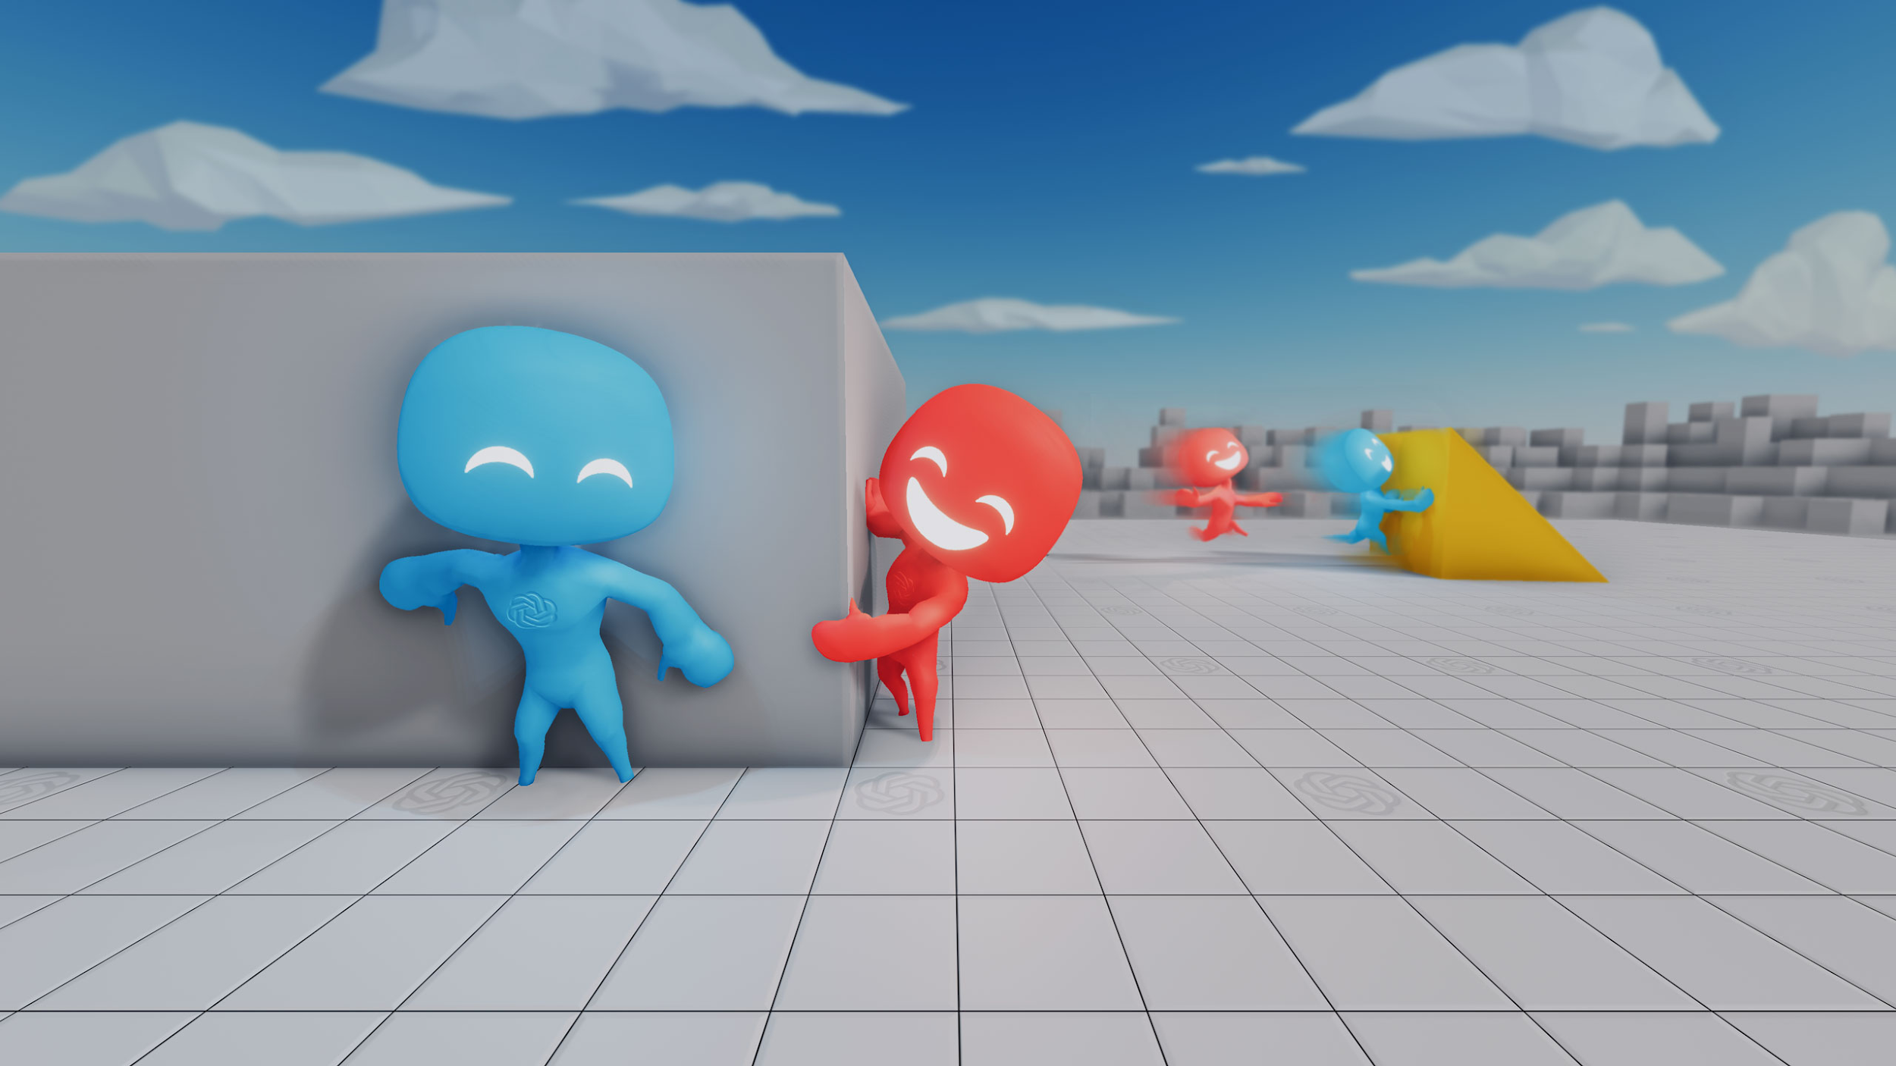
Hide-and-seek (1/3)
Hiders are given a reward of +1 if all hiders are hidden and -1 if any hider is seen by a seeker. Seekers are given the opposite reward, -1 if all hiders are hidden and +1 otherwise.
Notes:
Emergent Tool Use From Multi-Agent Autocurricula (OpenAI, Sep 2019)

Slide 50
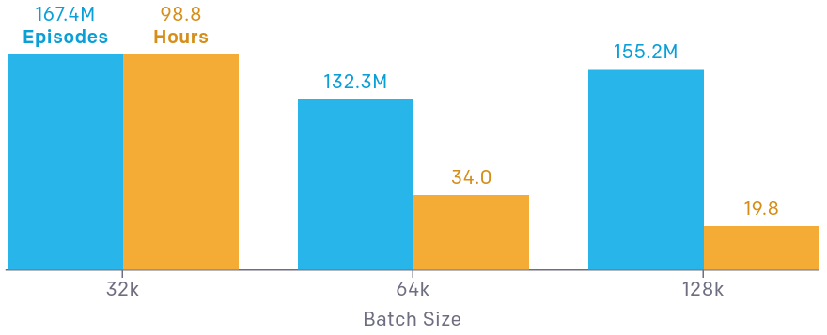
Hide-and-seek (2/3)
Agent acts independently and their policies are trained with self-play + PPO.
"We found that batch sizes of 8k and 16k never reached stage 4 ..."

Slide 51
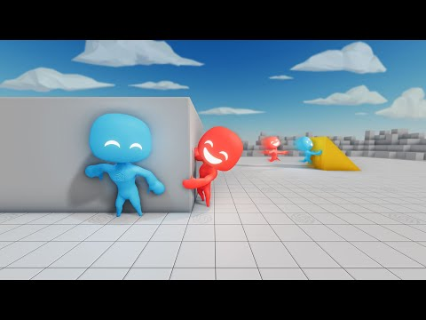
Hide-and-seek (3/3)
“When a new successful strategy or mutation emerges, it changes the implicit task distribution neighboring agents need to solve and creates a new pressure for adaptation.”

Slide 52
Social Influence as Intrinsic Motivation (1/5)
A mechanism for achieving coordination in multi-agent RL through rewarding agents for having causal influence over other agents' actions.
Actions that lead to bigger changes in other agents' behavior are considered influential and are rewarded.
Influence is assessed using counterfactual reasoning.
Notes:
Social Influence as Intrinsic Motivation for Multi-Agent Deep Reinforcement Learning (DeepMind + MIT + Princeton, Oct 2018)

Slide 53
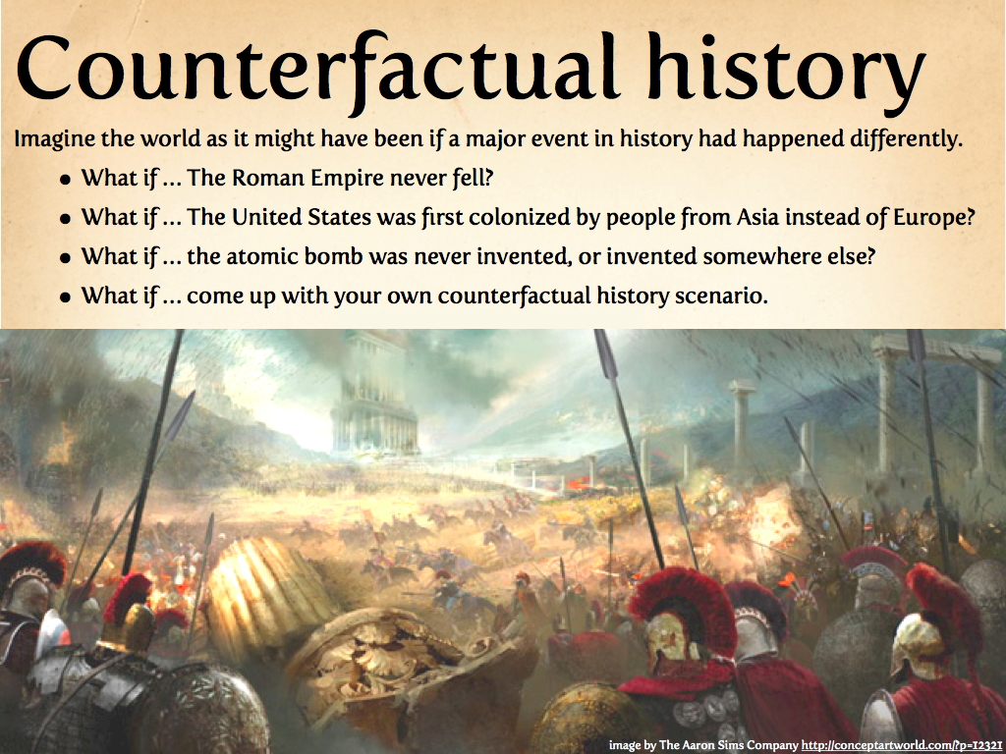
Social Influence as Intrinsic Motivation (2/5)
An example of "counterfactual"
Notes:
We often ﬁnd ourselves asking counterfactual questions of the form, “How would she have acted if I had done something else in that situation?”, which we answer using our internal model of others.

Slide 54

Social Influence as Intrinsic Motivation (3/5)
In Sequential Social Dilemmas (SSD) games, an individual agent can choose to defect or cooperate.
The defector can almost always benefit from defecting.
But the more agents that defect, the worse the outcomes for all agents.
Notes:
囚徒困境

Slide 55

Social Influence as Intrinsic Motivation (4/5)
An agent's immediate reward is modified:
environmental reward + causal influence reward
Notes:
利用上帝視角算出 influence reward（因為可以知道其他 agent 會採取什麼行動），也就是 centralized training。
在得知 agent k 的 action 以後，如果 agent j 因此改變了自己的 action，則 agent k 便知道這個 action 很有影響力，也因此得到較多 reward。

Slide 56

Social Influence as Intrinsic Motivation (5/5)
Notes:
利用所有 agent 上一步的 actions 來預測所有人下一步的 actions（綠色部分）。

Slide 57

AlphaStar (1/3)

Slide 58

AlphaStar (2/3)
Notes:
Grandmaster level in StarCraft II using multi-agent reinforcement learning (DeepMind, August 2019)
別人的 replay buffer 是存玩過的遊戲，我的 replay buffer 是 replay ”player” buffer。

Slide 59

AlphaStar (3/3)

Slide 60
THE END
Any questions?

